Slide 1
How to Pay for College
(in just six easy steps)
Enter Name
Enter School
GE-6944839.1 (8/24)(Exp. 8/26)
Enter Date
Notes:
Complete slide

Slide 2
What are we going to talk about today? Life after graduation! Here’s my college story.
SPEAKER INSERT SLIDES AND PERSONAL MATERIAL HERE
Notes:
Add College Logo, Photo from Campus and/or Photo of You in College
Why did you select your college?
What major did you study?
Who helped your navigate classes, financing college, deciding a major etc.
Note: Equitable Advisors FPs should have their content on this slide reviewed by branch compliance prior to use.

Slide 3
Plans after high school?
What kind of job or career are you thinking about at this point?
Do you have college or career education plans?
In an ideal world, where would you like to be in two – five years?
Notes:
Probing questions, ask students for feedback? Who has a plan? Who has visited a college/campus? What are you excited about? What may be causing you angst in thinking about college? Assure students all the answers/feelings are normal and to be expected when making such a big decision.

Slide 4
Life After Graduation
1
Lots of educational opportunities.
Leading to good jobs.
Really.
2
College and trade schools may be
cheaper than you think.
How?
3
There’s government money:
Grants, loans and work-study.
Federal and state.
4
There’s also college aid:
For financial need and for merit.
Big discounts.
5
How do you get this money?
Filling out the FAFSA.
Three easy steps.
Notes:
So much information at your fingertips, do the research, ask for help! Many others have navigating this and many of us have made mistakes that we want to help you avoid as you navigate life after high school.

Slide 5
1
Educational
Opportunities &
Good Jobs
Notes:
Begin to set this section up with examples of careers you considered, careers your friends are engaged with, careers you see on tv etc. Just get students thinking about careers. KEY point… talk in terms of CAREERS…. Not jobs. Jobs are fleeting. Careers are long term, building, growing etc.

Slide 6
What kind of college or training do you think
you will need?
Notes:
Read from Slide

Slide 7
Life After Graduation:
Good Jobs at All Education Levels
WHAT JOBS ARE YOU THINKING ABOUT?
Medical & Mental Health
Business & Trades
Technology & Consulting
Security & Policing
EMT to Brain Surgeon
Medical Technician
Phlebotomist
Social Worker
LPN/Registered Nurse
Nurse Practitioner
Doctors/Psychiatrist
Bartender to CEO
Sales/Customer Service
Bookkeeper/Admin Asst
Carpentry & Construction
Plumbing or Building
Business Owner
CEO
Help Desk to Venture Capitalist
IT Support
Data Analyst
Design & Coding
Computer Engineering
Technology Architect
Chief Information Officer
Hired Hacker to FBI Director
Security/Cmty Outreach
Police Officer or Fireman
Cyber-Security
Forensics
Detective/Investigator
Head of Trust & Safety
Notes:
Read some examples from the slide. Ask students what roles they are familiar with? Have heard of before? Create Q&A, ask for participation on this slide. Create dialogue.

Slide 8
Life After Graduation:
Good Jobs at All Education Levels
Travel & Leisure
Media & Arts
Government & Nonprofits
Transportation & Trucking
Ticket Sales to Airline Pilot
Hotel Desk & Reservations
Bartending & Waiting
Theme Parks & Kid Fun
Flight Attendants & Staff
Tour Guide & Tourism
Top Chef
Artist to Movie Director
Social Media Planner
Graphic & Web Design
Journalist/Influencer
Media Sales/Advertising
Architecture
Hollywood Executive
Case Worker to Mayor
Counselors & Coaches
Community Organizer
Teachers & Principals
Local & Federal Government
Lawyers & Judges
President
Taxi Driver to Ship Captain
Hail Service/Delivery
Bus Driver
Interstate Trucking
Car/Aircraft Mechanics
Highway Engineer
Air Traffic Controller
Notes:
Give examples.. Share insights/roles/organizations in your community that may spark interest or familiarity with these role? Ask the question, who knows…… a bus driver? A Lawyer? Etc.

Slide 9
Example: Growing in the Nursing Field
Promotional Opportunities & Your Education Path
Medical Technician/Assistant
Licensed Practical Nurse
Registered Nurse
Nurse Practitioner (Doctor Duties)
Job Training or Industry Certification
Industry Certification or
Associate’s Degree
Bachelor’s Degree and
Job Training
Master’s Degree or
Advanced Medical Degree
AVERAGE SALARY IN NYC:
$45,260/year
$22/hour
DEGREE OR TRAINING?
Employer training or college certificate
AVERAGE SALARY IN NYC:
$67,983 /year
$33 /hour
DEGREE OR TRAINING?
Employer training, college certificate or associate’s degree
AVERAGE SALARY IN NYC:
$92,968/year
$45/hour
DEGREE OR TRAINING?
Associate’s degree or bachelor’s degree with clinical experience
AVERAGE SALARY IN NYC:
$133,469 /year
$64 /hour
DEGREE OR TRAINING?
Master’s degree with clinical experience
See Zip Recruiter: https://www.ziprecruiter.com/Salaries
Notes:
Share resources/zip recruiter, US Labor statistics and career sites, search terms to begin exploring types of roles. Home : Occupational Outlook Handbook: : U.S. Bureau of Labor Statistics (bls.gov)

Slide 10
How much will your college or career education cost?
WHAT DO YOU THINK A FULL DEGREE COSTS?
Trade school or vocational training?
Two-year associate’s degree?
Four-year bachelor’s degree?
An additional two-year master’s degree?
An additional three- to four-year professional degree?
Notes:
Read from slide.

Slide 11
How much will your college or career education cost?
Trade school or vocational training? $5,000 - $15,000
Two-year Associate’s degree? $7,000 - $35,000
Four-year Bachelor’s degree? $108,000 - $225,000
Additional two-year Master’s degree? $56,000 - $75,0000
Additional two- to four-year professional degree? $50,00 - $400,000
Note: Costs vary greatly depending on the college location, student residency, financial aid, and other factors.
Sources: Education Data Initiative: https://educationdata.org/average-cost-of-college, https://educationdata.org/average-cost-of-a-masters-degree and others.
Notes:
Read from slide.

Slide 12
Where will this college money come from?
Notes:
Read from slide.

Slide 13
2
College May
Be More Affordable
Than You Think
Notes:
A school’s cost of attendance (COA) is simply the estimated cost per academic year to attend that school. Included in this amount are your tuition and fees, room and board, books and supplies, and other costs such as transportation. The COA for your chosen school is likely to change from one academic year to the next.

Slide 14
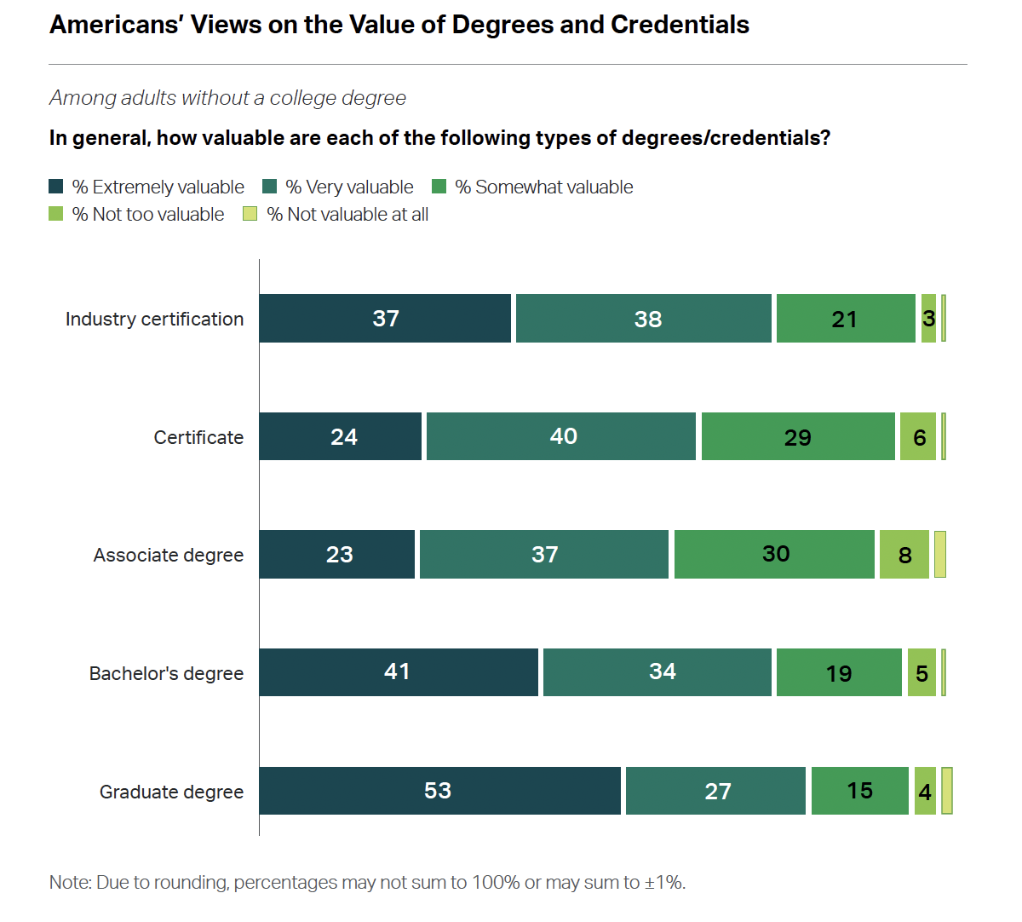
#1
There are lots of education options to choose from
Excited about going away to college?
Looking for a credential to get a good job quickly?
Have your sights set on a professional degree?
There are many educational options to choose from. They are all popular with the American public, as this recent Gallup poll shows.
The key is to choose the path that is right for you.
Think about the career you want. What kind of education do you need immediately? What do you need to spend now? Can you build your education and credentials over time?
Notes:
Read from slide.

Slide 15
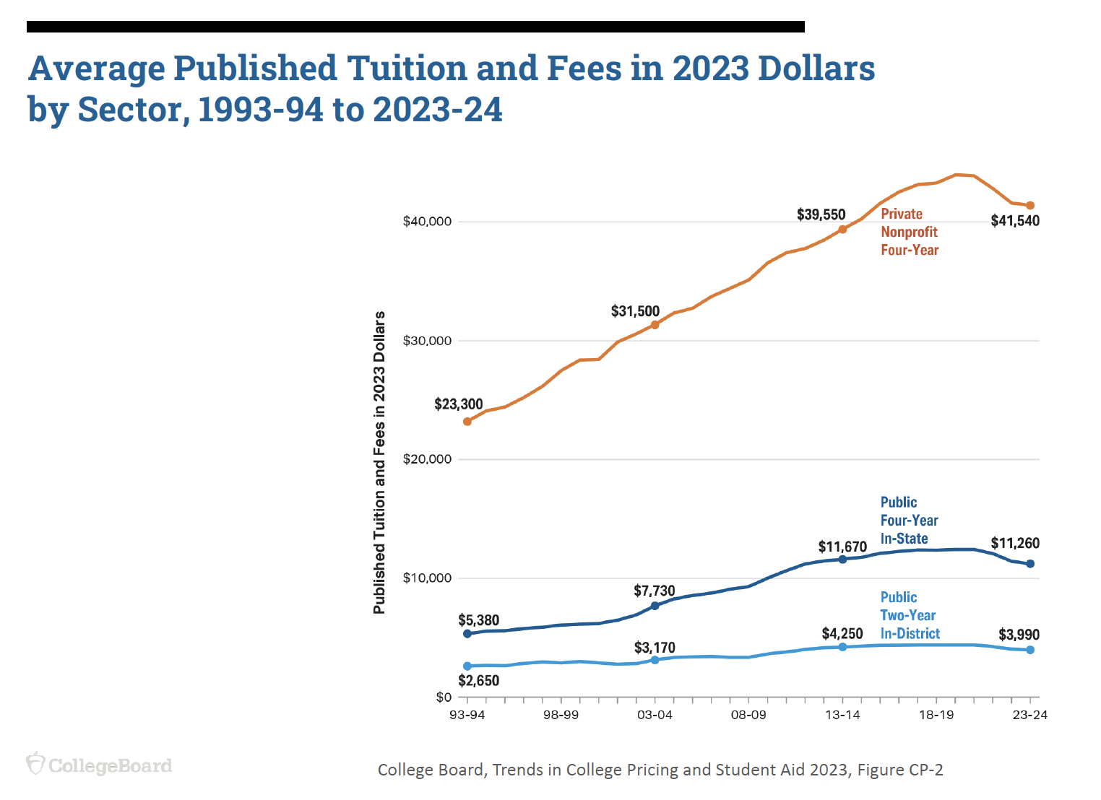
#2
Students usually pay less than the college
“sticker price”
Colleges publish a “sticker price” on their website, but students usually pay less than this after getting need-based aid and college scholarships. This is called your ”net price.”
Half-price off! The average tuition discount rate at private colleges was 56% for freshmen attending in the 2023-2024 school year, according to the National Association of College and University Business Officers. Discounts are at an all-time high.
Attending a public college in your state could save you even more money. This chart shows how tuitions differ. Apply to both public and private colleges – and then compare offers.
Notes:
Read from slide.

Slide 16
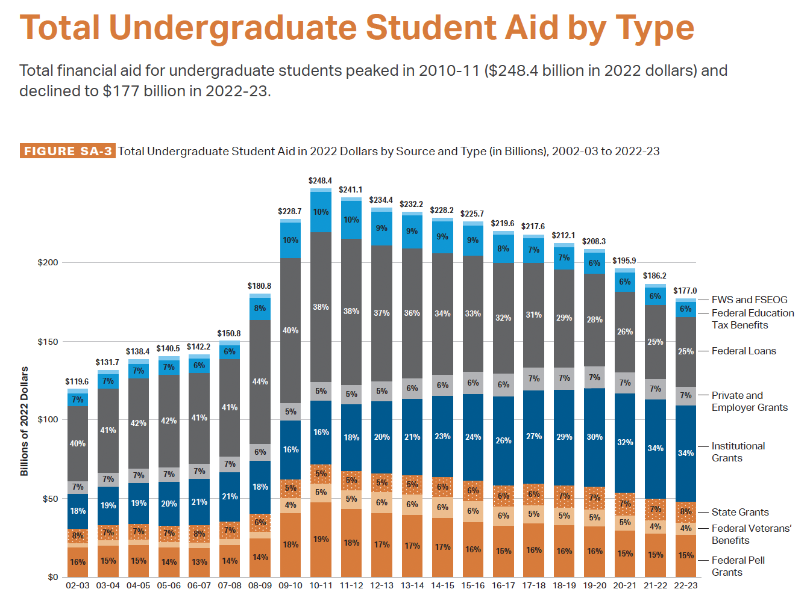
#3
Families have a mix of aid options to make school affordable
How much money will you need to attend college or career school? You will need to know your school’s “cost of attendance” and how much aid the school will give you.
This will be different for every school you apply to. The good news is that there is a lot of aid available, including government grants, college scholarships, student loans, and federally funded college jobs.
Students and families need to decide what is affordable. Colleges may offer lots of grants and loans, but what will you have to pay at the end of the day? Create a budget and stick to it!
Notes:
Read from slide.

Slide 17
What kind of college financial aid will be available for me?
Notes:
Read from slide.

Slide 18
3
Financial Aid:
Government
Grants & Loans
Notes:
Read from slide.

Slide 19
College Financial Aid from the Federal Government
1
2
3
4
PELL GRANTS
SUBSIDIZED LOANS
UNSUBSIDIZED LOANS
PARENT PLUS LOANS
LOAN FORGIVENESS FOR NEEDED PROFESSIONS
Notes:
Also known as Federal Stafford loans, both subsidized and unsubsidized loans are awarded by the federal government to eligible students who are enrolled at least half-time at a participating school.
These government loans can be attractive to students and their families because:
Interest rates are fixed and do not change over the life of the loan.
Eligibility is not credit-based; every approved borrower receives the same limits, rates, and terms.
Flexible repayment options are available, including income-driven repayment plans

Slide 20
College Financial Aid from State Governments
Each state will have different types of programs available
1
2
3
4
GRANTS & SCHOLARSHIPS
INTER-STATE LOW-COST
TUITION
AGREEMENTS
GRANTS & LOW-COST LOANS FOR
NEEDED PROFESSIONS
LOAN FORGIVENESS FOR NEEDED PROFESSIONS
Notes:
Read from slide.

Slide 21
4
College Aid:
Need-Based Aid,
Merit Aid &
Private Scholarships
Notes:
Read from slide.

Slide 22
Financial Aid from Colleges & Private Donors
1
2
3
4
GRANTS FOR STUDENTS WITH FINANCIAL NEED
COLLEGE SCHOLARSHIPS TO BRING DOWN THE COST OF SCHOOL
(COLLEGE DISCOUNT)
MERIT AID TO RECRUIT STUDENTS WITH CERTAIN TALENTS
(ACADEMICS, SPORTS, COMMUNITY, ARTS)
PRIVATE SCHOLARSHIPS
APPLY ON YOUR OWN & THROUGH YOUR COLLEGE
Notes:
Great time to share Equitable Excellence as an example of a private scholarship. Share/have students take note of Scholarship America “Scholarship Hub”
Browse Scholarships in the Student Hub - Scholarship America

Slide 23
How do I get all of this college money?
Notes:
Read from slide.

Slide 24
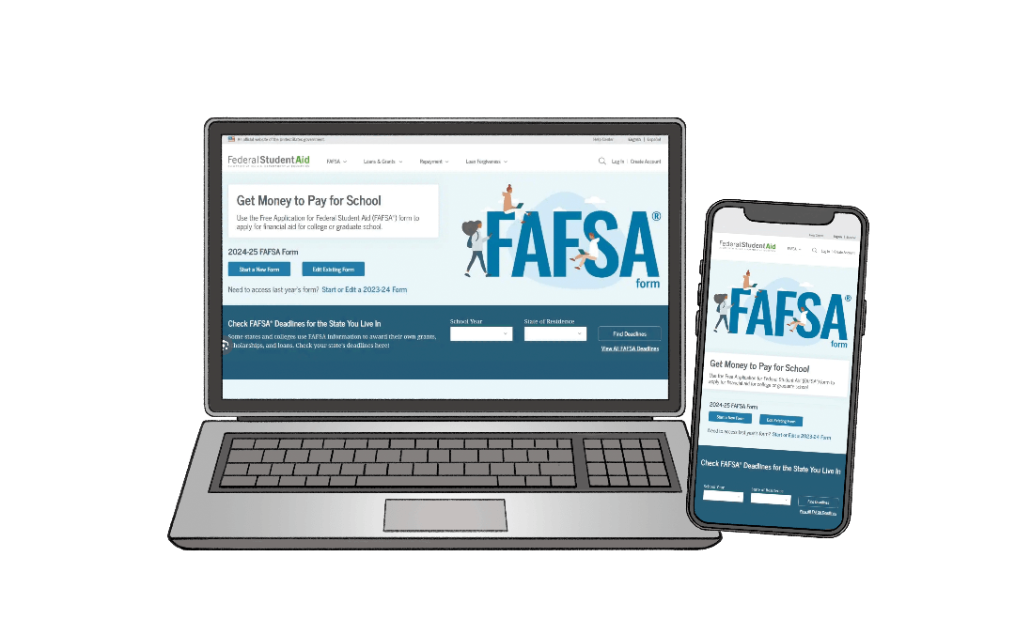
You fill out the FAFSA!
Notes:
Direct students to: What is the FAFSA® form and why should I fill it out? | Federal Student Aid

Slide 25
5
Fill Out the FAFSA: Six Easy Steps
Notes:
Ask students to write/take notes

Slide 26
What is the FAFSA?
Notes:
Direct students to FAFSA 101 website: Financial Aid - College Money Matters

Slide 27
Free Application for Federal Student Aid One online form to apply for all kinds of college aid
https://studentaid.gov/h/apply-for-aid/fafsa
Notes:
Each school and state has its own deadline for completing the FAFSA form. Many states have limited funds available. Completing the FAFSA form by the applicable deadlines is the best way to ensure that your child is eligible for as much aid as possible for college, career school, or trade school.

Slide 28
Why do I need to fill it out?
Notes:
Create discussion. Why is receiving/obtaining funds for college important? Why would it be valuable to graduate college with least amount of debt possible? What are things upon graduation would you like to do? Buy a house? Buy a car? Start Saving for retirement? Investing?

Slide 29
Qualifying for student financial aid will help
guide planning for
future life events.
Notes:
Read from slide.

Slide 30
What will I need to do?
Notes:
Read from slide.

Slide 31
The 24-25 FAFSA will open on December 1st
Notes:
You can start preparing and getting organized TODAY! Being prepared and getting ready for the 12/1 launch will help you get ahead of the process.

Slide 32
Filling Out the FAFSA:
Six Easy Steps
Step #1
Step #2
Step #3
Get Organized
Get Your FSA ID
Fill Out the FAFSA
Gather Tax & Legal Documents
Students & Parents Need FSA IDs
Read Carefully & Answer Questions
Gather your ID documents, financial statements & taxes from two years ago.
Class of 2025? Find your 2023 tax forms.
Gather documents with your legal name and SSN
Gather banking & asset documents.
You will need this secure government login to fill out the FAFSA & apply for government t aid.
Search: ”Create FSA ID”
Follow the instructions. Get all info exactly right using your legal docs.
Take screenshots or safely save your login information. You will use this login a lot.
Hopefully, this will go quickly. Most income information is uploaded automatically from the IRS.
Search: ”FAFSA.gov”
Watch the welcome videos.
Consent to sharing your tax info.
Answer the questions, reading slowly & typing carefully.
Notes:
We’ve broken into 6 easy steps. Please take out your pen. Let’s write these down together. 1. Get organized. 2. …. 3. ….

Slide 33
Filling Out the FAFSA:
Six Easy Steps
Step #4
Step #5
Step #6
Invite Your Parents
Submit the Form
Watch Your Email
One Person Starts & Invites Others
Everyone Done? Sign & Submit
Watch for FAFSA & College Requests
Each family member does their own part of the FAFSA. Ideally, students start the FAFSA and invite parents to help.
You'll be asked a few questions about your parents.
You will be given instructions on which parent (or parents) need to help.
Use the electronic invite form to send them a secure link.
Or your parents can start the form and "invite" you to help.
The student and parents each complete their part of the form.
Once the last person signs and submits, you’ll see ”Congratulations!”
Watch your email for your FAFSA Submission Summary.
Problems? Search: ”FAFSA Help Center”
Be sure to check your email frequently and respond to any problems or requests.
See a red exclamation point on your FAFSA Submission Summary? Click that tap & see what’s needed.
Watch for info requests from your colleges and respond quickly.
Notes:
Step 4: Parent involvement of the form is important here. You can go deeper by sharing this site with your parents/guardians: 8 Steps for Parents Completing the 2024–25 FAFSA® Form – Federal Student Aid

Slide 34
What happens next?
Notes:
Read from slide.

Slide 35
Wait for Your College Acceptances & Compare Your Financial Aid Offers
2
Review your FAFSA
Submission Summary
OK? Fix any problems
4
Wait for your college acceptance offers
6
Read and compare your offers carefully
1
Submit your FAFSA
3 Colleges receive your FAFSA information
5
Watch for your college aid offers
7
Choose a college you like and can afford!
Notes:
Read from slide.

Slide 36
Q&A
Notes:
Any questions?

Slide 37
Read More & Get Help
College & Career Websites
College Costs & Benefits
Filling Out the FAFSA
1
US News College Rankings
1
The State of Higher Education 2024 (Gallup/Lumina)
1
FAFSA Application
Start here for your college search
Fill this out to get financial aid
2
Niche College Rankings
2
Trends in College Pricing and Student Aid 2023 (College Board)
2
FAFSA Contact Center
Students love these rankings
One stop for the help you need
3
Zip Recruiter Salary Calculator
3
Average Cost of College & Tuition (Education Data Initiative)
3
Create Your FSA ID
Find out what your career is worth
Do this today & take your first step
Notes:
A listing of more resources.

Slide 38
For more questions
XX XX
XX@equitable.com
Equitable believes that education is a key step toward addressing your financial goals, and this presentation is designed to serve simply as an informational and educational resource. Accordingly, this material does not offer or constitute investment advice and makes no direct or indirect recommendation of any particular product or of the appropriateness of any particular investment-related option. Your needs, goals, and circumstances are unique, and they require the individualized attention of your financial professional. But for now, take some time just to learn more.
Notes:
Add in contact information, headshot, and email address.

Slide 39
Thank you!
Notes:
Read from slide.

Slide 40
Equitable Financial, Equitable Advisors, its affiliated companies and its associates are not affiliated with any school, state or federal agency and/or educational funding program. Student financial aid programs are subject to change. While we believe the information in this presentation is current and accurate, any discrepancies between the information provided in this presentation and any information given directly by the state or federal student financial aid programs, the latter will prevail.
Through the Equitable Foundation, we actively contribute to the betterment of students’ education and support for educators. We aid students by providing grants through our Equitable Excellence scholarships ®.
Please be advised that this presentation is not intended as legal or tax advice. Accordingly, any tax information provided in this presentation is not intended or written to be used, and cannot be used, by any taxpayer for the purpose of avoiding penalties that may be imposed on the taxpayer. The tax information was written to support the promotion or marketing of the transaction(s) or matter(s) addressed, and you should seek advice based on your particular circumstances from an independent tax advisor.​
Equitable Advisors financial professionals offer securities through Equitable Advisors, LLC (NY, NY (212) 314-4600), member FINRA, SIPC (Equitable Financial Advisors in MI & TN). Annuity and insurance products offered through Equitable Network, LLC. Equitable Network conducts business in CA as Equitable Network Insurance Agency of California, LLC; in UT as Equitable Network Insurance Agency of Utah, LLC and in PR as Equitable Network of Puerto Rico, Inc. Individuals may transact business, which includes offering products and services and/or responding to inquiries, only in state(s) in which they are properly registered and/or licensed.
Equitable is the brand name of the retirement and protection subsidiaries of Equitable Holdings, Inc., including Equitable Financial Life Insurance Company (Equitable Financial) (NY, NY); Equitable Financial Life Insurance Company of America (Equitable America), an AZ stock company with an administrative office located in Charlotte, NC; and Equitable Distributors, LLC. Equitable Advisors is the brand name of Equitable Advisors, LLC (member HYPERLINK "https://finra.org"FINRA, HYPERLINK "https://sipc.org"SIPC) (Equitable Financial Advisors in MI & TN). The obligations of Equitable Financial and Equitable America are backed solely by their claims-paying abilities.
© 2024 Equitable Holdings, Inc. All rights reserved.
1345 Avenue of the Americas, NY, NY 10105. (212) 554-1234
GE-6944839.1 (8/24)(Exp. 8/26)

